Slide 1




CODE BUDDIES
HACKTOBERFEST 1.0

Slide 2






Calorie Tracker
The core issue that a calorie tracker business model seeks to address is assisting individuals in effectively managing and tracking their daily calorie consumption, which can lead to better weight management and healthier eating habits.
The problem of managing calorie intake is crucial for our target audience as it impacts their health and well-being directly.
1. Globally, over 1.9 billion adults were overweight in 2016.
2. Obesity-related conditions, like heart disease and diabetes, are leading causes of preventable premature death in the U.S.

Slide 3




Solution
Our innovative business strategy combines profit-making with social impact to create a sustainable solution for the tech industry.

Slide 4


Key Features and Functionality
USER-FRIENDLY INTERFACE WITH INTUITIVE NAVIGATION.
ROBUST SEARCH FUNCTIONALITY TO EASILY FIND DESIRED CONTENT.
CUSTOMIZABLE SETTINGS TO TAILOR USER EXPERIENCE.

Slide 5


Social impact
The social impact goals and objectives are to:
1. Promote healthier lifestyles and weight management.
2. Educate users on nutrition.
3. Enhance long-term well-being.
4. Ensure accessibility and inclusivity.
5. Foster community support.
6. Prioritize data privacy.
7. Continuously improve the platform.

Slide 6
Social impact
Social impact
WAYS TO MEASURE AND TRACK YOUR SOCIAL IMPACT.
1. Promote healthier lifestyles and weight management.
2. Educate users on nutrition.
3. Enhance long-term well-being.
4. Ensure accessibility and inclusivity.
5. Foster community support.
6. Prioritize data privacy.
7. Continuously improve the platform.
ALIGN YOUR BUSINESS MODEL WITH YOUR SOCIAL IMPACT GOALS.

Slide 7

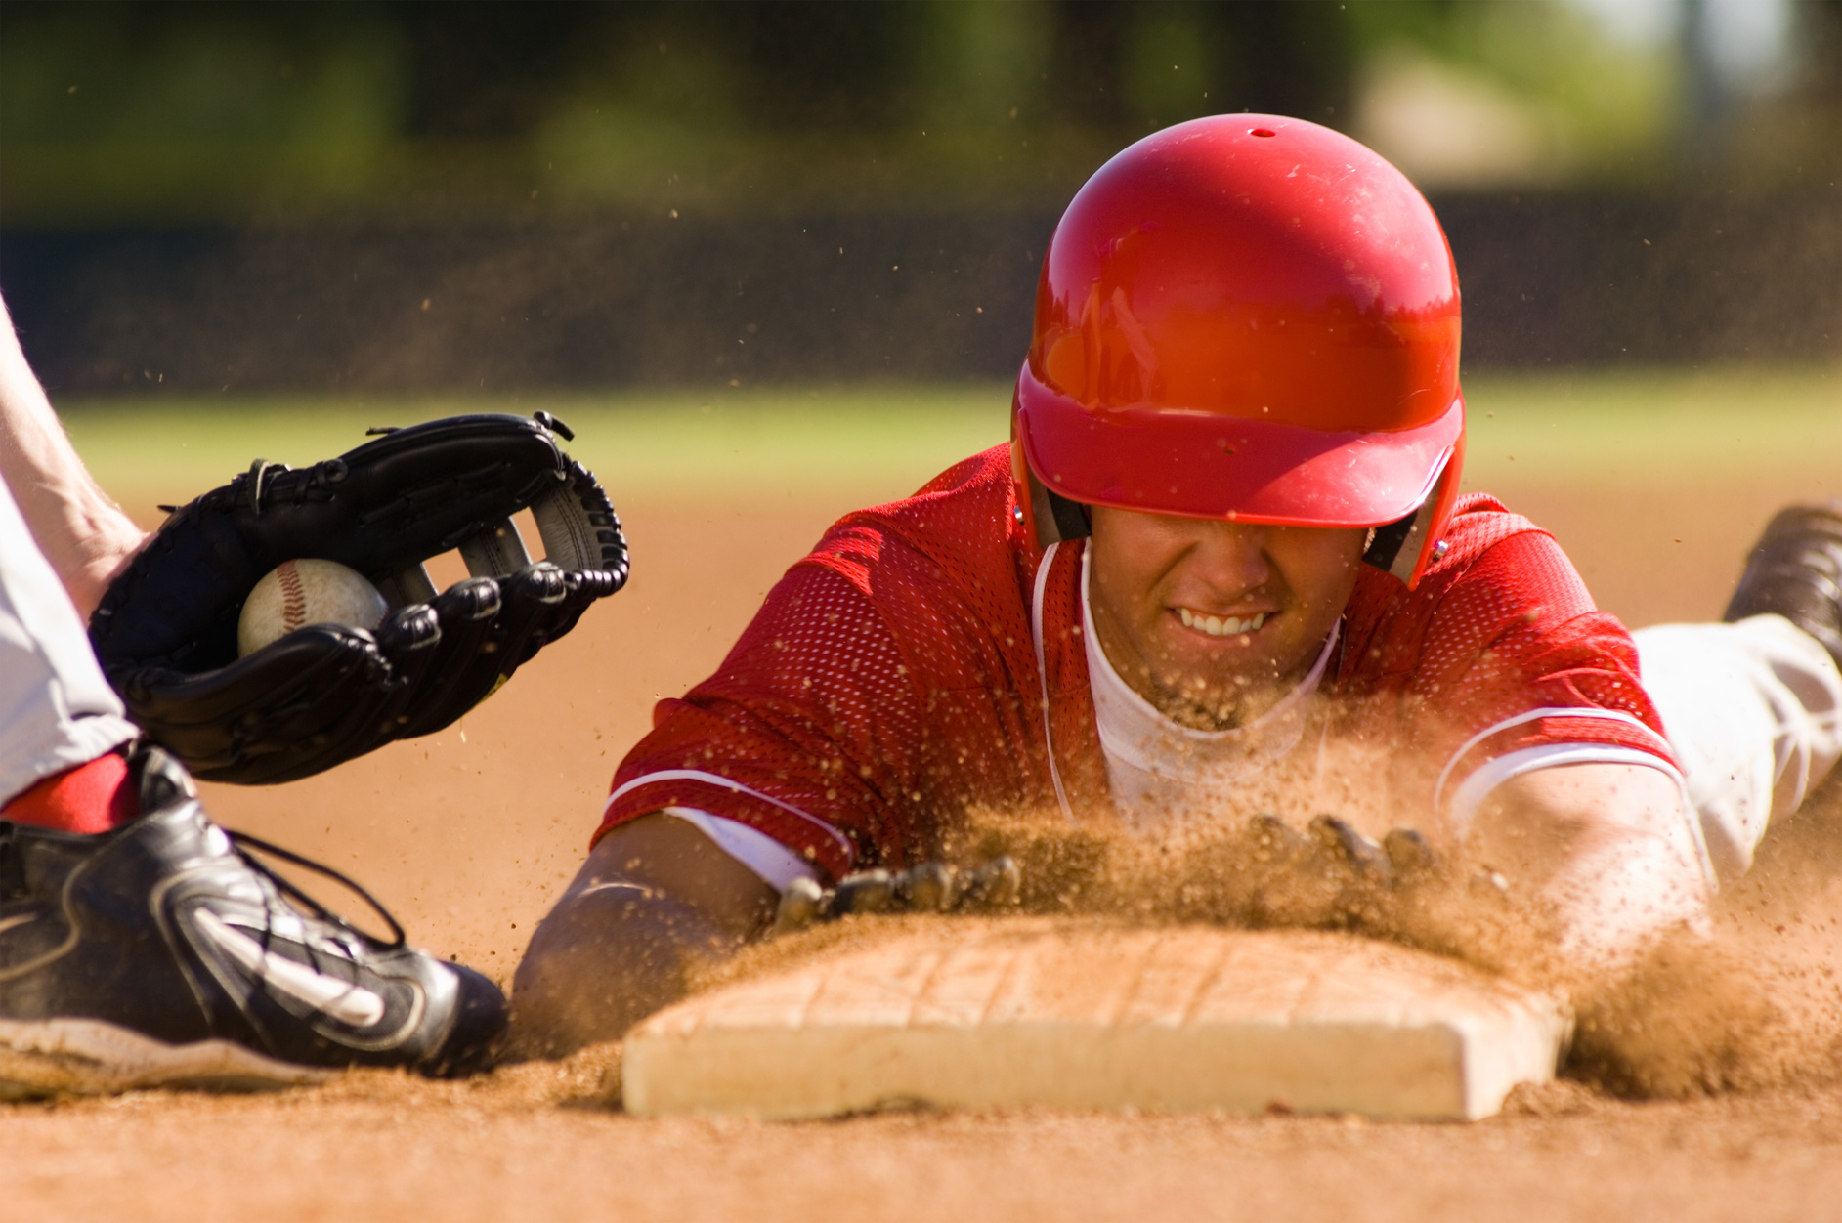
Revenue Model
Our calorie tracker business model creates social value by promoting healthier lifestyles, nutritional awareness, and inclusivity, ultimately contributing to a better world with improved well-being and a sense of community.

Slide 8



Technologies Used
OUR TEAM UTILIZED A VARIETY OF TECHNOLOGIES INCLUDING HTML,CSS,JAVASCRIPT,REACT,NODE JS,EXPRESS.

Slide 9



The Team
Sai Ram Thimmisetty
Bandala Hyndavi
Team Leader

Slide 10


Thank You
HACKTOBER FEST

